Slide 1
Section 8.2
Separation of Variables

Slide 2
All graphics are attributed to:
Calculus,10/E by Howard Anton, Irl Bivens, and Stephen Davis Copyright © 2009 by John Wiley & Sons, Inc. All rights reserved.

Slide 3
First-Order Separable Equations
When we have a first-order equation that is in the form h(y) $\frac{dy}{dx}$ = g(x), it is often desirable to “separate the variables” (get all terms with x on one side and all terms with y on the other side of the equation).
First-order equations are called separable when they can be rewritten h(y) dy = g(x) dx if you multiply both sides of the equation by dx.
After that, you take the integral of the left side of the equation with respect to y and take the integral of the right side of the equation with respect to x.
You will get the anti-derivative of both sides (shown with capital letters) in the form H(y) + $C_{1}=G\left(x\right)+ C_{2}$.
If you subtract $C_{1}$ from both sides, you will get:
H(y) $=G\left(x\right)+C \left(which is a constant\right).$

Slide 4
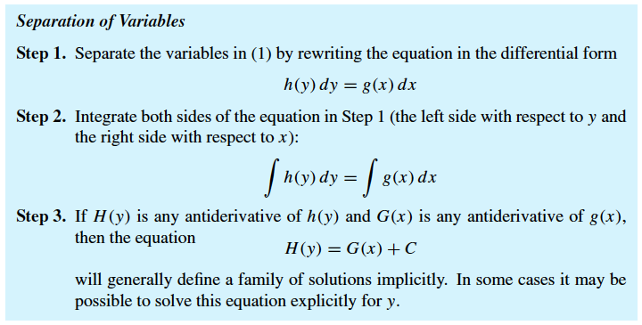
Steps
STEPS:
Separate variables
Integrate
Result = family

Slide 5
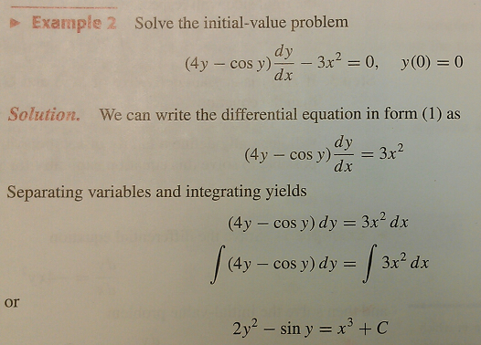
Initial-Value Example
This answer is the “implicit family of solutions” (see graph on next slide).
Now, we use the initial condition y(0)=0 (plug 0 in for x and 0 in for y) to solve for the constant C which gives us the following when we solve for x:
x = $\sqrt[3]{2y^{2} −\sin{y}}$.

Slide 6
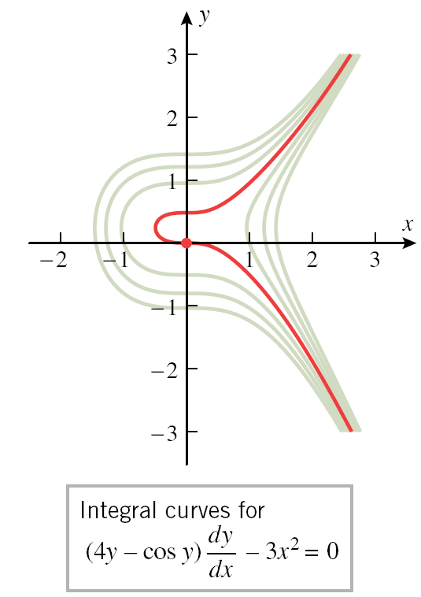
This answer is the “implicit family of solutions” (see graphs below).
We want the one that passes
through the point (0,0) in red.
x = $\sqrt[3]{2y^{2} −\sin{y}}$

Slide 7
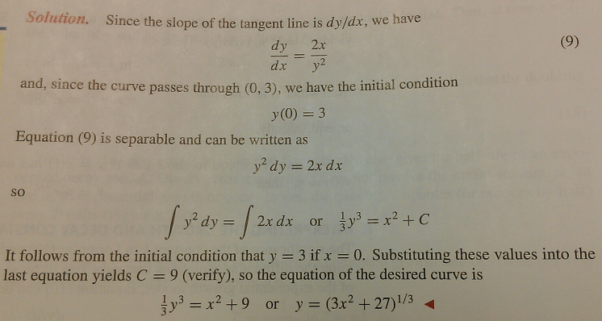
Example
Find a curve in the xy-plane that passes through (0,3) and whose tangent line at a point (x,y) has slope $\frac{2x}{y^{2}}$.

Slide 8
Exponential Growth and Decay Models
Exponential models often arise in situations where something is increasing or decreasing at a rate that is proportional to the amount present (similar to direct variation and/or compound variation that you learn in Algebra II).
There were a few of these in section 8.1.
Exponential growth model: $\frac{dy}{dt}=ky$
Exponential decay model: $\frac{dy}{dt}=−ky$
(where k is the growth or decay constant and y is the function giving the amount present at a given time, often y = $y_{0}e^{kt}$for exponential growth or y = $y_{0}e^{−kt}$ for exponential decay)
NOTE: proof is on pages 571-572

Slide 9
Formal Definition

Slide 10
Interpreting the Growth and Decay Constants
If we solve the exponential growth model equation $\frac{dy}{dt}=ky$ for k by dividing both sides by y, we get $\frac{\frac{dy}{dt}}{y}$ = k.
k = $\frac{\frac{dy}{dt}}{y}$ is the relative growth rate because you are comparing the rate of change $\frac{dy}{dt}$ to the amount present y.

Slide 11
Example – Growth Rate Given
According to the U.S. Census Bureau, the world population in 2011 was 6.9 billion and growing at a rate of about 1.10% per year. Assuming an exponential growth model, estimate the world population at the beginning of the year 2030.
Solution:
Define variables: t=years since 2011, y=world population (in billions)
Initial condition: $y_{0}$ = y(0) = 6.9
Use exponential growth: y = $y_{0}e^{kt}$ = $6.9e^{.011t}$
Substitution: y(19) = $6.9e^{.011(19)}≈8.5$ billion people.

Slide 12
Doubling Time and Half-Life
With an exponential growth model, the time required to double = doubling time = T = $\frac{1}{k}$ln2 (proof on page 572-573).
With an exponential decay model, the time required for half of the amount to decay = half-life.

Slide 13
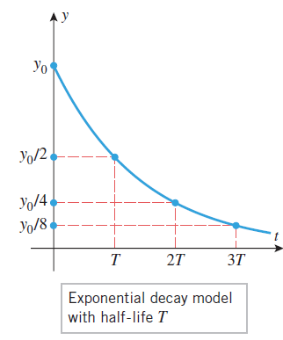
Graphs of Doubling Time and Half Life

Slide 14
Example con’t
According to the U.S. Census Bureau, the world population in 2011 was 6.9 billion and growing at a rate of about 1.10% per year. Assuming an exponential growth model, estimate the doubling time of the world population.
Solution #1:
Define variables: t=years since 2011, y=world population (in billions)
Initial condition: $y_{0}$ = y(0) = 6.9
Use exponential growth: y = $y_{0}e^{kt}$ = $6.9e^{.011t}$
Double population is 2$y_{0}$: 13.8= $6.9e^{.011(t)}$
Divide both sides by 6.9: 2= $e^{.011(t)}$
Convert to ln form: ln 2 = .011t
Divide both sides by .011: It will take apprx. 63 years for the population to double
Solution #2 (use formula T = $\frac{1}{k}$ln2) : T = $\frac{1}{.011}$ln2 $≈$63 years

Slide 15
Radioactive Decay
Radioactive elements disintegrate spontaneously.
Experiments show that the rate of disintegration is proportional to the amount of material present as we have seen with medicine, population, disease, etc.
These facts can be used in carbon dating to estimate the age of an artifact that contains plant or animal material.

Slide 16
Radioactive Decay Example
In 1988 the Vatican authorized the British Museum to date a cloth relic. The report of the British Museum showed that the fibers in the cloth contained between 92% and 93% of their original carbon-14. Use this information to estimate the age of the shroud.
NOTE: decay constant for carbon-14 is k $≈$ -.000121
Solution:
Define variables:t=years of decay, y=amount of carbon-14 present
Use exponential growth: y = $y_{0}e^{kt}$ =$y_{0}e^{−\text{.000121 }t}$
Divide both sides by $y_{0}$: $\frac{y}{y_{0}}$=$e^{−\text{.000121}t}$
NOTE: $\frac{y}{y_{0}} is 92 or 93\%:$ $.92$=$e^{−\text{.000121}t}$
$.93$=$e^{−\text{.000121}t}$
5. Convert to ln form and solve: t $≈$600 or t $≈$689 years old.

Slide 17
At my brother’s wedding

